Slide 1

NOIDA INSTITUTE OF ENGINEERING & TECHNOLOGY GREATER NOIDA
CSDS- VII SEM HUMAN PSYCHOLOGY & OB
UNIT 4
Group Dynamics

Slide 2
Syllabus
Unit –I
Introduction to OB, Definition, Nature, and Scope – Environmental and organizational context – Impact of globalization, Diversity, Ethics, culture. Importance of OB in understanding Human Behavior. Cognitive Processes, I: Perception and Attribution: Nature and importance of Perception – Perceptual selectivity and organization, Social perception – Attribution Theories, Locus of control –Attribution Errors.
Unit –II
Cognitive Processes, II: Personality and Attitudes, Personality as a continuum - Meaning of personality, Johari Window and Transactional Analysis, Nature, and Dimension of Attitudes -Job satisfaction and organizational commitment, Motivational needs and processes, Theories of Motivation

Slide 3
SYLLABUS
Unit –III
Stress and Conflict: Meaning and types of stress, Stress Management, Meaning and types of conflict, Effect of stress and intra individual conflict, Conflict management.
Unit –IV
Groups Vs. Teams – Nature of groups – dynamics of informal groups – dysfunctions of groups and teams, teams in modern work place. Power and Politics: Meaning and types of power – empowerment.
Unit –V
High performance work practices, Behavioral performance management: reinforcement and punishment as principles of Learning –Process of Behavioral modification, Leadership theories, Styles, Activities, and skills of Great leaders. Organizational change, meaning, factors in Organizational change, process of planned Change, Resistance to change.

Slide 4
SYLLABUS
Text books:
Robbins Stephen P& Judge Timothy A. Organizational Behavior (2019, 9th edition, Pearson)
Newstrom J. W., & Davis, K. (2011) Human behavior at work (12th ed.). Tata McGraw Hill
Reference Books:
Robbins & Coulter: Management (Pearson, 19th Edition, 2019)
Luthans Fred: Organizational Behavior, (McGraw Hill International Edition, 12th Edition, 2013)
Prasad L. M.: Principles and Practices of Management, (Sultan Chand& Sons, 9th edition,2016)
Pareek. U. (2010). Understanding Organizational Behavior (2nd ed.). Oxford University Press

Slide 5
COURSE OBJECTIVES
To understand the various dimensions of Human psychology.
To familiarize students with the concept of Organizational Behavior.
To enable students to describe how people behave under different conditions and understand why people behave as they do.
To introduce students to the concepts of Team and Organization change.

Slide 6
Brief Introduction of Subject: Video
(2) 1. Introduction To Organizational Behaviour, Nature & Scope Of OB |OB| - YouTube
(2) 2. Environmental and Organizational Context in OB, Types Of Environment |OB| - YouTube
(2) 12 "SHOCKING" PSYCHOLOGICAL FACTS - THAT WILL MAKE YOUR LIFE EASY | Rewirs - YouTube

Slide 7
UNIT CONTENT
Groups Vs. Teams – Nature of groups – dynamics of informal groups – dysfunctions of groups and teams, teams in modern work place. Power and Politics: Meaning and types of power – empowerment

Slide 8
UNIT OBJECTIVES
Objectives of this unit is:
To Explore the concept of Group Dynamics.

Slide 9
Prerequisites
Student should have general understanding of general management and its terms.

Slide 10
CONCEPT OF GOALS
A group is several people who work together. They have individual goals that they work toward collectively.
Groups work toward separate goals, they have a related interest or identity that brings them together.

Slide 11
TYPES OF GROUPS
There are two types of groups: informal groups and formal groups.
Informal groups are formed naturally around common interests, identities, or social goals.
Formal groups are created by company leaders to perform a specific task for an organization.

Slide 12
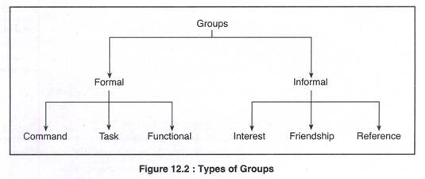
Types of Groups

Slide 13
GROUP ADVANTAGES
There is some debate about whether groups or teams are better. The reality is, both have advantages and disadvantages, and it is up to you to decide which one is best for your needs. Here are some advantages of groups:
Groups build temporary relationships
Groups are great for efficiency
Groups focus on individual growth

Slide 14
GROUP DRAWBACKS
While groups support individual work and career growth, they do not share all the advantages of working in a team setting. These disadvantages include not connecting work to goals and the lack of team bonding.
Here are some disadvantages of working in a group:
Groups can alienate individuals
Groups do not support organizational goals

Slide 15
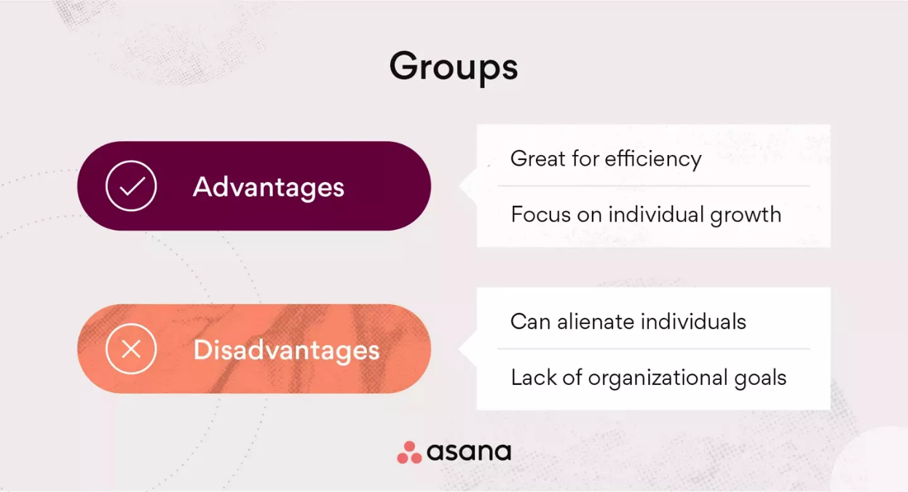
Group Advantages & Drawbacks

Slide 16
Concept of Team
A team is several people who work together to accomplish a shared purpose or goal.
Each team is the sum of its parts, which means members of the team rely on one another to accomplish the outcome.
Teams work together to solve problems, create new products, and other functions such as aligning passions and purpose.

Slide 17
TEAM ADVANTAGES
Working in a team environment has many advantages that all come back to working toward the same goals and supporting members in a shared experience. Many organizations work in a team setting vs. a group setting as they prefer the advantages of collaboration. These include improved productivity and quicker problem solving.
Here are some advantages of working in a team:
Teams build on collaboration and synergy
Teams encourage group productivity
Teams are better for problem solving

Slide 18
TEAM DRAWBACKS
While teams have a variety of advantages, they also have some disadvantages. These disadvantages include struggling to support individual growth and efficiency issues.
Here are some disadvantages of working in a team:
Teams do not always focus on individual growth
Teams may struggle with efficiency

Slide 19
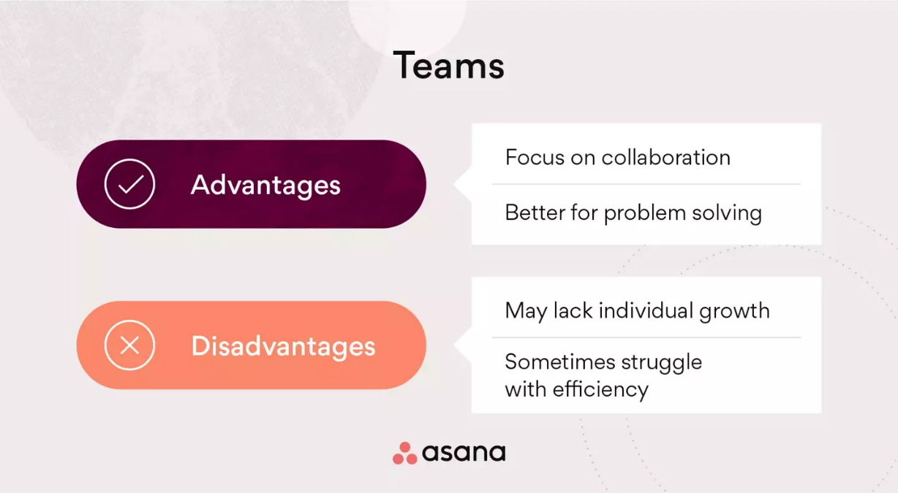
TEAM ADVANTAGES AND DISADVANTAGES

Slide 20
How to lead groups vs. teams
Now that you know the advantages and disadvantages of groups vs. teams, you may be wondering how each translates into an organization. This is an important question to consider when gauging how to lead a group or team in your current organization.
Group-focused organizations
Team-focused organizations

Slide 21
Group-focused organizations
When it comes to group organizational Behavior, there is a lot to consider based on functionality and group dynamics. Group dynamics describe the interactions, attitudes, and behaviours between a set of people. These can negatively and positively affect teamwork depending on how they are set up.
Healthy group dynamics consist of fluid collaboration and transparency. Unhealthy group dynamics might consist of a lack of teamwork which results in individual isolation. To prevent unhealthy group dynamics, implement a team-focused strategy that focuses on breaking down communication barriers.
Group leadership tip: To prevent communication issues, organize team building games to encourage group collaboration and healthy dynamics.

Slide 22
Team focused organizations
When Organizations that are focused around team dynamics tend to have more transparency and fewer communication issues.
This is because teams work together toward a shared goal and focus on problem solving together.
This leads to a healthy organizational Behavior and positive interdependent relationships.
To take this one step further, keep collective goals in sight, and empower your team to rely on one another to meet the objectives.

Slide 23
Group vs. Team
A group is a collection of individuals who coordinate their efforts, while a team is a group of people who share a common purpose. To improve working relationships, it is important to understand the differences between the two to encourage healthy working dynamics. While similar, the two are different when it comes to decision-making and teamwork.
In a work group, group members are independent from one another and have individual accountability. On the other hand, in a team, team members share a mutual accountability and work closely together to solve problems. These dynamics inform the way tasks are handled and overall collaboration.

Slide 24
DIFFERENCE BETWEEN GROUP AND TEAM
The difference between group and team in the workplace can be drawn clearly on the following grounds:
There is only one head in a group. A team can have more than one head.
The group members do not share responsibility, but team members share the responsibility.
The group focuses on achieving the individual goals. Conversely, the team members focus on achieving the team goals.
The group produces individual work products. As opposed to, the team who produces collective work products.
The process of a group is to discuss the problem, then decide and finally delegate the tasks to individual members. On the other hand, a team discusses the problem, then decide the way of solving it and finally do it collectively.
The group members are independent. Unlike a group, the team members are interdependent.

Slide 25
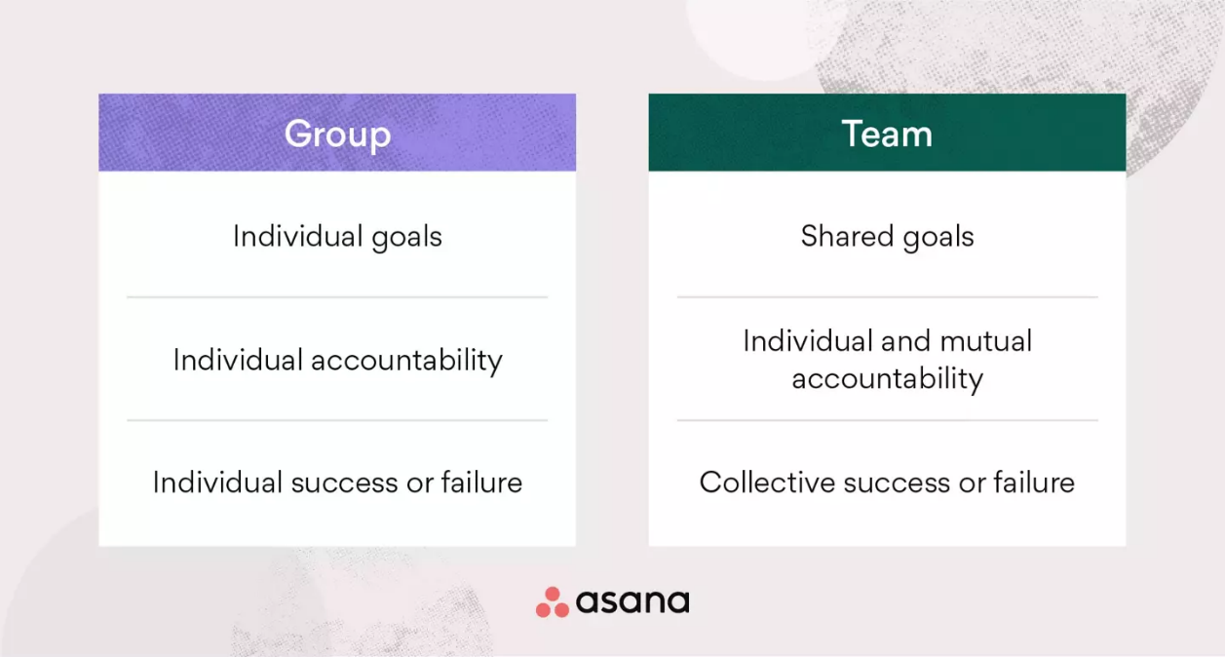
Cont..

Slide 26
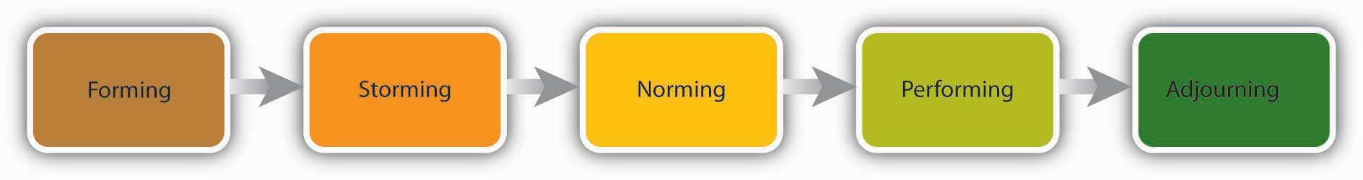
STAGES OF GROUP DEVELOPMENT
According to Bruce Tuckman’s theory, there are five stages of group development. The five-stage group-development model is:
Forming
Storming
Norming
Performing
Adjourning

Slide 27
Cont..
Forming (Getting Familiar):
The first stage, forming stage, faces a great amount of uncertainty about the group’s purpose, structure, and leadership amongst the members of the group. This stage is complete when members have begun to think of themselves as part of a group.
Storming (Conflicts and Learning):
The Storming stage is one of intra-group conflict. Members accept the existence of the group but resist the constraints it imposes on individuality. There is conflict over who will control the group. When this stage is complete, there will be a relatively clear hierarchy of leadership within the group.

Slide 28
STAGES OF GROUP DEVELOPMENT
Norming (Understanding One’s Role and Other’s Role):
In the third stage Norming, close relationships evolve and the group develops cohesiveness. This Norming stage is complete when the group structure solidifies and the group has assimilated a common set of expectations of what defines the correct behaviour of members.
Performing (Achieving the Set Goals):
The fourth stage is Performing. The structure at this point is fully functional and accepted. Group energy has moved from getting to know and understand each other to perform the task at hand. For permanent workgroups, performing is the last stage in development.
Adjourning (Break-off):
However, for temporary committees, teams, task forces, and similar groups that have a limited task to perform, the Adjourning stage is for wrapping up activities and preparing to disband.

Slide 29
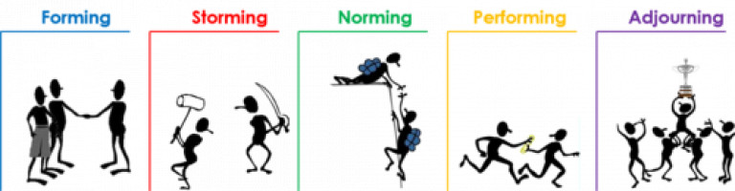
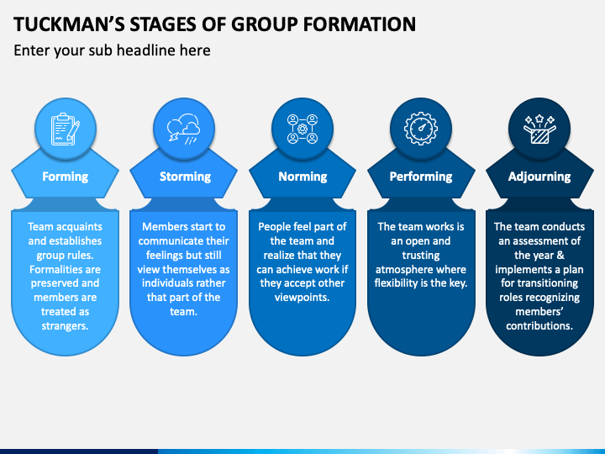
Cont..

Slide 30
GROUP DYNAMICS
A group is a two or more individual who interact regularly with each other in an organization to accomplish a common purpose or goal.
Dynamics is a word that has Greek origin. It means force.
Therefore, Group Dynamics relates to the study of different forces that are operating within an organization or a group.
Group Dynamics studies the interaction taking place within a group (intragroup). It also considers the interaction that takes place within each group.

Slide 31
Theories of Group Dynamics
1. Propinquity/Proximity Theory
This theory states that individuals and groups can affiliate with one another because of spatial or geographic proximity. The more near people are at the workplace, the more probability they have to be in groups.
2. Homan’s/Activity/Interaction Theory
According to this theory, more the involvement through activities, more the interactions and more the emotions and therefore more the probability to be in groups.

Slide 32
Cont..
3. Balance Theory
This theory claims that persons are attracted to one another on the basis of similar attitudes towards commonly relevant objects and goals. The given theory is the additive of above two theories and balance between Propinquity and Homan’s theory.
4. Exchange/Benefit Theory
According to this theory, the outcome of a relationship must be rewarding in order to have attraction or affiliation among the members of a group.

Slide 33
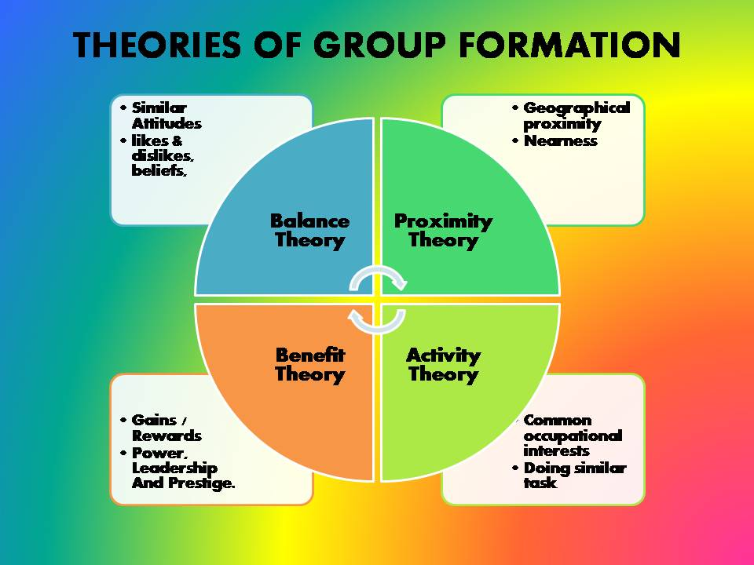
Cont.

Slide 34
CLASSIFICATION OF GROUP DYNAMICS
With the advancement of societies, several social groups emerged over the course of time.
Since every such group has its own ideologies and attitudes, each one functions differently.
Individual members with differing thought processes exert even more influence in their functioning.
This is why we need to study the classification of groups to understand how they operate.
We can classify groups into the following general categories:

Slide 35
Cont…
Primary v. Secondary Groups:
Primary groups are those which are generally small and emerge due to feelings of intimacy or friendship. For example, family groups, groups of friends in offices, etc.
On the other hand, secondary groups are much larger and are based on the mutual beliefs of members. The members of these groups might not interact with each other personally. For example, associations of people belonging to a profession, like doctors or lawyers, are secondary groups.
2. Membership v. Reference Groups
Membership groups are those to which people belong, while reference groups are those to which they wish to belong.

Slide 36
Cont..
3) Command v. Task Groups
Command groups involve a hierarchical structure wherein a member with a superior rank oversees other members. For example, the manager of a shop and his subordinate sales staff will become a command group.
In a task group, members perform the same functions but they do not share a hierarchical command structure. For example, all the sales staff members together subordinate to the manager of the shop.
4) Interest v. Friendship Groups
An interest group always involves members sharing common and mutual goals. For example, a firm of partners will be an interest group. A friendship group, however, need not have common interests but members share mutual attributes. For example, they may belong to the same place or support the same sports team.

Slide 37
CLASSIFICATION OF GROUP DYNAMICS
5) Psychological v. Social Groups
In a psychological group, two or more members interdependent on each other together influence other members as well. For example, parents in a family might dictate how all family members will behave.
A social group comprises of interrelated psychological groups that have the same objectives. For example, members of regional offices of a company along with those at its headquarters.
6) Formal v. Informal Groups
Formal groups are those which emerge out of a formal authority that has specific objectives. For example, a trade union will be a formal group. The members of formal groups behave according to their mutual goals.
Informal groups emerge not from formal authorities but rather from personal or social interactions. The members of these groups might or might not have specific common goals. These groups generally emerge from feelings of friendship or camaraderie.

Slide 38
5 Dysfunctions of a Team: What They are and How to Overcome
The 5 dysfunctions take the form of a pyramid that resembles Maslow’s hierarchy of needs; just like Maslow, Lencioni believes that you cannot resolve the issues of a higher level without attending to the lower-level needs first.
Each dysfunction has a direct impact on a team’s performance and hampers overall productivity. The good news is that you, as a manager, with leadership and management skills can overcome all these dysfunctions.

Slide 39
Cont…
The 5 dysfunctions of a team are:
Lack of Trust
Fear of Conflict
Lack of Commitment
Avoidance of Accountability
Inattention to Results

Slide 40
5 Dysfunctions of a Team: What They are and How to Overcome
1. Lack of Trust
The lack of trust is about the fear to be vulnerable. Still, protecting one’s sense of invulnerability, individuals do not let the team develop, engage in meaningful work conflict, and reach better outcomes.
Teams that lack trust…
Conceal weaknesses and mistakes from each other
Do not ask for help or a piece of advice
Hesitate to help when it is outside their own area of responsibility
Hesitate to offer feedback or compliment one’s skills
Hate meetings and avoid spending time together.

Slide 41
5 Dysfunctions of a Team: What They are and How to Overcome
Solution for Lack of Trust
You can overcome this dysfunction helping the team members focus on strengths rather than weaknesses in other members and in themselves too.
Knowledge of one’s strengths helps to build confidence and will thus free individuals from the fear to show their weaknesses. Discussion of individual strengths will also inspire team members to recognise and appreciate the skills of their teammates and help related to what they are good at.
Overcoming this dysfunction, you will get the team that…
Feels comfortable working together towards a common goal
Can quickly react to issues that are no longer silenced
Can prevent mistakes by giving timely feedback and assistance to each other
Motivate each other appreciating others skills and strengths

Slide 42
Cont…
2. Fear of Conflict
Workplace diversity contributes to better results, but it also presupposes that people will have different or even opposing ideas about their work. You won’t be able to benefit from diversity if the opposing ideas are held back for fear of conflict.
Teams that fear conflict…
Hesitate to voice opinions and concerns
Ignore controversial topics even if they have potential to determine team’s success
Have more interpersonal conflicts and personal attacks
Have backchannel communication and politics

Slide 43
5 Dysfunctions of a Team: What They are and How to Overcome
Solution for Fear of Conflict
A good test that will help you determine if you have this type of dysfunction in your team is suggesting an obviously bad idea on a team meeting. If your team accepts the idea without any attempt to discuss or oppose it, you have a problem to resolve.
A good way to resolve it is by assigning “a devil’s advocate” on the meeting. Let one person find faults with any suggestion that is voiced encouraging other members to defend their point of view. This will show your team that voicing opposing ideas is good for the project. It will also train your team to find faults with the ideas not people that voice them.

Slide 44
5 Dysfunctions of a Team: What They are and How to Overcome
To determine how each member approaches conflict and coach the team on how to debate with one another based on unique strengths of the members.
Overcoming the fear of conflict in your team, you will get a team that…
Leverages diversity and exploits the ideas of everyone on the team
Quickly solves the problems
Openly discusses critical topics and concerns
Minimizes politics

Slide 45
5 Dysfunctions of a Team: What They are and How to Overcome
3. Lack of Commitment
If the team members avoid open discussion of controversial topics and don’t clearly understand why this or that decision has been taken, they fail to commit to the adopted course of action or team goals overall.
Teams that lack commitment…
Lack confidence and are in fear of failure
Discuss the same topics or decisions repeatedly
Make ambiguity and second-guessing thrive
Fail to seize opportunity spending too much time on planning

Slide 46
Cont…
Solution for Lack of Commitment
There are several strategies that might help you overcome this dysfunction of a team.
First, make it a rule to summarise all key decisions made during the meeting and the rationale for taking them.
You can also facilitate the commitment by encouraging the team to discuss possible pitfalls and worst-case scenarios; again, clarity is the basis for commitment.
This way, team members will assume responsibility to arrive at the best possible decision and commit to it, rather than just postpone the solution.

Slide 47
Cont…
When you overcome this dysfunction, your team will…
Clearly understand work directions and priorities
Share common goals and objectives
Be ready to change
Not let the fear of mistake prevent it from moving forward

Slide 48
5 Dysfunctions of a Team: What They are and How to Overcome
4.Avoidance of Accountability
People are used to emphasizing personal responsibility for one’s actions. This is why individuals do not like to interfere with what other team members do or don’t do. Still, this is counterproductive for the team, where the common result depends on members’ ability to hold each other accountable for personal decisions and actions.
Teams that avoid accountability…
Make high performers discouraged
Miss deadlines
Make team leaders overwhelmed as the sole source of discipline
Remain mediocre

Slide 49
Cont…
Solution for Avoidance of Accountability
You may resolve this dysfunction by holding regular progress reviews and rewarding team achievements rather than individuals. Make it clear for individuals that hold high standards of performance as their HIGH5 strength that holding others accountable will be appreciated and rewarded. If the team has successfully overcome the fear of conflict, they will be ready to tackle this dysfunction too.
When your team learns to hold each other accountable, they will…
Quickly identify potential problems questioning each other’s actions and approaches
Respect their team and the organisation for applying the same standards to everyone
Avoid excessive management of performance, fines and corrective actions
Pressure poor performers to improve

Slide 50
Cont…
5. Inattention to Results
This dysfunction of the team stems from the individuals’ focus on their own achievements or status at the expense of collective results. Such focus can make team members do something that is not promoting collective goals just to get individual recognition or enhance their ego.
Teams that are not focused on collective results…
Lose achievement-oriented team members
Get distracted from collective goals easily
Fail to develop
Lose market competition

Slide 51
5 Dysfunctions of a Team: What They are and How to Overcome
Solution for Inattention to Results in a Team
For your team to keep focus on common results, it is vital to have clear metrics to assess results.
If the team already knows how to keep each other accountable, they will push each other toward pursuing common not individual goals. As in the case with the avoidance of accountability, rewards should be based on team rather than individual results and achievements.
If the urge to get individual recognition or please one’s ego is a part of a team member’s personality, it is not necessary to fight or punish it. Instead, use strengths based approach and make sure individuals’ zeal align well with the common goals.

Slide 52
What is Power
Power is the ability to influence the behaviour of others to get what you want.
Gerald Salancik and Jeffery Pfeffer concur, noting, “Power is simply the ability to get things done the way one wants them to be done” (Salancik & Pfeffer, 1989).
If you want a larger budget to open a new store in a large city and you get the budget increase, you have used your power to influence the decision.

Slide 53
Sources of Power
Having power and using power are two different things.
For example, imagine a manager who has the power to reward or punish employees.
When the manager makes a request, he or she will probably be obeyed even though the manager does not actually reward the employee. The fact that the manager has the ability to give rewards and punishments will be enough for employees to follow the request.
Researchers identified six sources of power, which include legitimate, reward, coercive, expert, information, and referent (French & Raven, 1960). you might earn power from one source or all six depending on the situation.

Slide 54
1. Legitimate Power
Legitimate power is power that comes from one’s organizational role or position.
For example, a boss can assign projects, a policeman can arrest a citizen, and a teacher assigns grades. Others comply with the requests these individuals make because they accept the legitimacy of the position, whether they like or agree with the request or not.
Steve Jobs has enjoyed legitimate power as the CEO of Apple. He could set deadlines and employees comply even if they think the deadlines were overly ambitious. Start-up organizations often have founders who use their legitimate power to influence individuals to work long hours week after week in order to help the company survive.

Slide 55
REWARD POWER
Reward power is the ability to grant a reward, such as an increase in pay, a perk, or an attractive job assignment.
Reward power tends to accompany legitimate power and is highest when the reward is scarce.
Anyone can wield reward power, however, in the form of public praise or giving someone something in exchange for their compliance.
When Steve Jobs ran Apple, he had reward power in the form of raises and promotions. Another example of reward power comes from Bill Gross, founder of Idealab, who has the power to launch new companies or not.

Slide 56
COERCIVE POWER
In contrast, coercive power is the ability to take something away or punish someone for noncompliance.
Coercive power often works through fear and it forces people to do something that ordinarily they would not choose to do.
The most extreme example of coercion is government dictators who threaten physical harm for noncompliance.
Parents may also use coercion such as grounding their child as punishment for noncompliance.
Steve Jobs has been known to use coercion—yelling at employees and threatening to fire them. When John Wiley & Sons Inc. published an unauthorized biography of Jobs, Jobs’s response was to prohibit sales of all books from that publisher in any Apple retail store (Hafner, 2005).

Slide 57
4. Expert Power
Expert power comes from knowledge and skill. Steve Jobs has expert power from his ability to know what customers want even before they can articulate it.
Others who have expert power in an organization include long-time employees, such as a steelworker who knows the temperature combinations and length of time to get the best yields.
Technology companies are often characterized by expert, rather than legitimate power.
Many of these firms utilize a flat or matrix structure in which clear lines of legitimate power become blurred as everyone communicates with everyone else regardless of position.

Slide 58
5. INFORMATION POWER
Information power is similar to expert power but differs in its source.
Experts tend to have a vast amount of knowledge or skill, whereas information power is distinguished by access to specific information.
For example, knowing price information gives a person information power during negotiations. Within organizations, a person’s social network can either isolate them from information power or serve to create it.

Slide 59
REFERENT POWER
Referent power stems from the personal characteristics of the person such as the degree to which we like, respect, and want to be like them.
Referent power is often called charisma—the ability to attract others, win their admiration, and hold them spellbound.
Steve Jobs’s influence as described in the opening case is an example of this charisma.

Slide 60
ORGANIZATIONAL POLITICS
Organizational politics are informal, unofficial, and sometimes behind-the-scenes efforts to sell ideas, influence an organization, increase power, or achieve other targeted objectives.
Politics has been around for millennia. Aristotle wrote that politics stems from a diversity of interests, and those competing interests must be resolved in some way.
"Rational" decision making alone may not work when interests are fundamentally incongruent, so political behaviours and influence tactics arise.

Slide 61
Organizational Politics
If power is a force, a store of potential influence through which events can be affected, politics involves those activities or behaviours through which power is developed and used in organizational settings.
Power is a property of the system at rest; politics is the study of power in action. An individual, subunit or department may have power within an organizational context at some period; politics involves the exercise of power to get something accomplished, as well as those activities which are undertaken to expand the power already possessed or the scope over which it can be exercised.

Slide 62
Employee Empowerment
Employee empowerment is a management philosophy that focuses on allowing an organization’s employees to make independent decisions and to feel empowered to take action as they see fit.
This is in contrast to micromanagement, which does not allow for independent decision making.
Companies that are interested in empowering employees should act on the following:
Give employees a voice by regularly soliciting and acting on their feedback.
Provide opportunities for employees to grow through more autonomy, additional responsibilities, or even an entirely new role.
Recognize employees frequently to increase their engagement and confidence in their own abilities.
And, of course, provide employees with the tools, training, and authority they need to excel.

Slide 63
EMPLOYEE EMPOWERMENT
A company’s leaders, HR professionals, and fellow employees all play key roles in establishing a supportive, empowered environment.
All parties need to establish mutual trust, feel comfortable taking risks, and establish clear expectations and guidelines.
Without this collaboration, truly empowering employees is impossible.

Slide 64
What are the 5 points of empowerment?
The five points, or ways to empower your employees starts with listening and recognition, and includes:
Fostering an environment of trust and psychological safety
Building employee confidence with recognition and incentives
Offering flexibility in work arrangements
Asking employees for feedback and actioning it
Supporting professional growth with coaching and delegation

Slide 65
Benefits of employee empowerment
Motivated employees
Greater trust in leadership
Improved creativity
Stronger bottom line Greater motivation
Higher productivity
Enriched company culture
More creativity in problem solving
Confident decision making
Reduced employee attrition
More trust in leadership
Improved customer experience
A better brand experience for customers
Better business outcomes

Slide 66
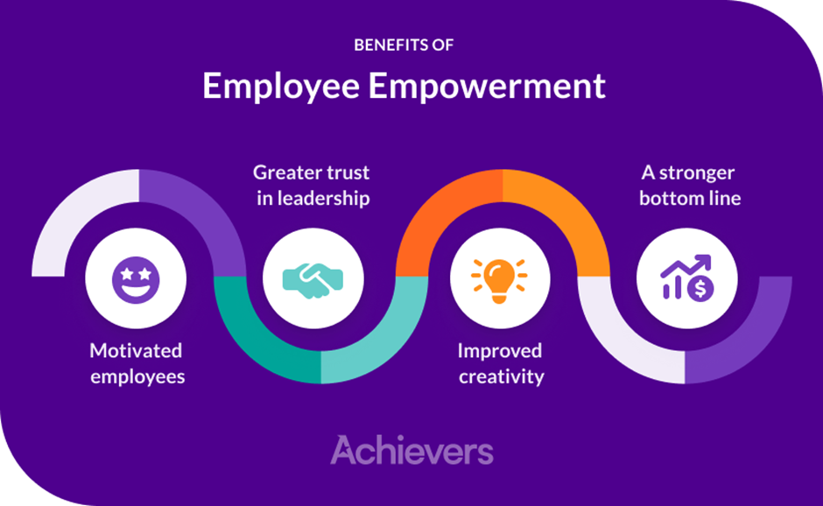
Benefits of employee empowerment

Slide 67
What does empowerment do for employees?
Empowering employees has several benefits, including:
Increased levels of employee engagement
Higher employee performance
Better quality of work
Elevated employee satisfaction
Improved business results

Slide 68
What are employee empowerment techniques?
There are several key ways to make employees feel empowered at work. Be sure to incorporate the following into your best practices:
Provide frequent feedback on their performance
Ensure that it is honest and constructive
Be clear and specific
Ensure that you highlight what they did well/their strengths

Slide 69
4 steps for empowering employees in the workplace
Show employees that their feedback matters
Recognize to empower
Provide opportunities for professional growth
Make empowerment part of your organization’s culture and vision
There are tremendous benefits to empowering employees, but ingraining it in a company’s culture takes a considerable level of focus.

Slide 70
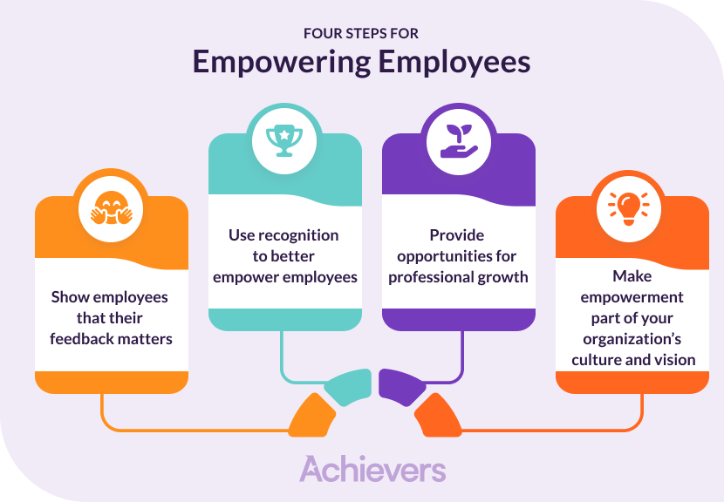
4 steps for empowering employees in the workplace

Slide 71
DAILY QUIZ
1. Organisational behaviour is_______
a) A science
b) An art
c) A science as well as an art
d) None of the above
2. Communication begins with _____
a. encoding
b. idea origination
c. decoding
d. channel selection
3. A study of the culture and practices in different societies is called _____
a) Personality
b) Anthropology
c) Perception
d) Attitudes

Slide 72
Thank You

